Slide 1
Lesson objective
Need whiteboards and calculators.
Title: Transferring data
Aim:
Transfer data between two-way tables and Venn diagrams
Plan:
Review basic probability
Probability from diagrams
Converting Venn into two-way tables

Slide 2
Sample space
Sample space:
A LIST of ALL possible outcomes.
Flipping a coin
Rolling a normal die
Days of the week

Slide 3
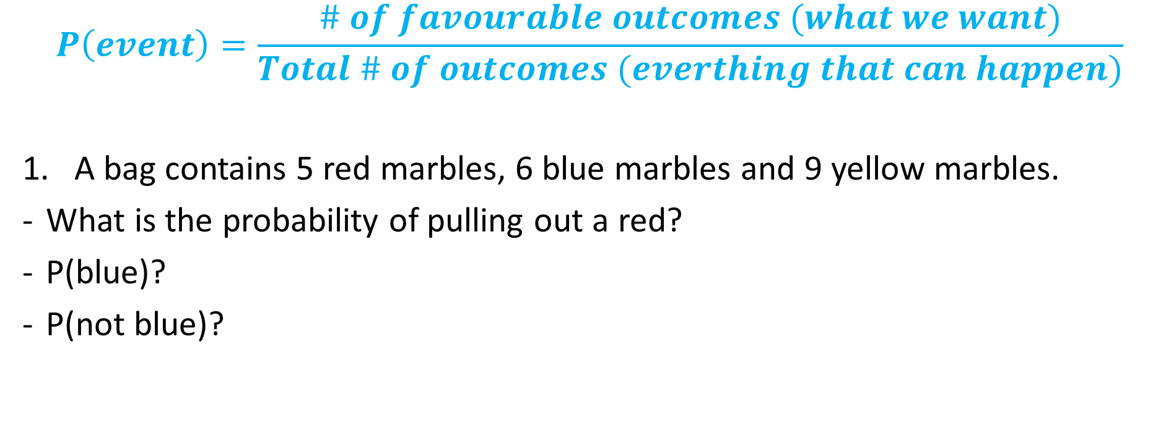
Probability
$$P\left(event\right)=\frac{\# of favourable outcomes (what we want)}{Total \# of outcomes (everthing that can happen)}$$
A bag contains 5 red marbles, 6 blue marbles and 9 yellow marbles.
What is the probability of pulling out a red?
P(blue)?
P(not blue)?

Slide 4
Basic probability
Each letter from the word CHANCE in written on a card and shuffled.
If we draw one out at random….
What is the sample space? How many outcomes?
Probability of getting the letter C?
P(H)?
P(vowel)?
P(not a vowel)?

Slide 5
Whiteboards
In a bag there are 2 red marbles, 3 green and 1 yellow.
If we pick one at random, what is the:
Sample space
How many outcomes in total?
P(green)?
P(not green)?
P(red or yellow)?

Slide 6
AND or OR
In probability we use And, and OR for conditions .
AND
Means the favourable outcome MUST have BOTH
OR
Means it can have 1 or the other, or BOTH
Unless it says “but not both”

Slide 7
Example
A coin is flipped, and a normal die is rolled.
 | 1 | 2 | 3 | 4 | 5 | 6
HEADS | H1 | H2 | H3 | H4 | H5 | H6
TAILS | T1 | T2 | T3 | T4 | T5 | T6
P(Heads and a 3) =
P(Head OR a 3) =
P(tails or even number) =

Slide 8
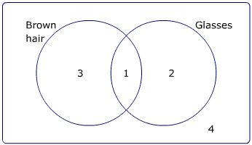
Whiteboards
Students were asked if they had brown hair or wore glasses.
How many students were asked?
If selected at random…
b) P(B hair and Glasses)
c) P(Only glasses)
d) P(brown hair or glasses)
e) P(not brown hair)
f) P(didn’t have either)

Slide 9
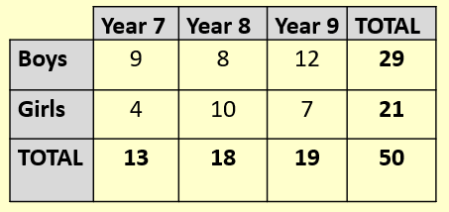
Whiteboards
Girls and boys from a school were surveyed.
How many in total?
Selecting students at random
b) P(year 8)
c) P(year 8 AND girl)
d) P(boy OR year 7 girl)

Slide 10
How to Create a Two Way Table
Read through all of the information first.
Pick out the different categories – men or women, boys or girls, types of colours, types of food etc.
Set out your table.
Fill in what you know
Creating 2 way-tables
Read info
Pick categories
Set table
Fill in what we know

Slide 11
Create a two way table
Creating 2 way-tables
Read info
Pick categories
Set table
Fill in what we know
90 people were asked whether they preferred Soaps, Drama or Crime shows.
12 men said they liked Dramas
33 people in total said they liked Soaps, and 27 of these were women.
25 people in total liked Dramas best.
Only 10 women liked Crime shows.

Slide 12
Create your own two way tables 6A – Problem solving with two way tables
A number of men and women were asked which types of crisps they liked best.
A total of twelve people said Plain, of which seven were men.
Six women said Salt and Vinegar.
Fourteen men and twelve women liked Cheese and Onion.
There were 28 men in total.
Q: How many people liked Salt and Vinegar best?

Slide 13
Answers
 | P | S + V | C + O | TOTAL
Men | 7 | 7 | 14 | 28
Women | 5 | 6 | 12 | 23
TOTAL | 12 | 13 | 26 | 51
13 people

Slide 14
Venn to two-way tables
 | Glasses |  | Total
Brown hair
Total

Slide 15
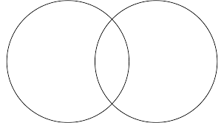
Whiteboards
Football
Soccer
 | Football | Not football | Total
Soccer
Not soccer
Total
15
5
10
5

Slide 16
Whiteboards
 | Surfing
Skate
Surfing
Skate
21
9
15
6

